Slide 1
Security and Control
Risk Assessment Plan
University Dining services

Slide 2
Team Members
Gowtham Chennavaram Risk Assessment Consultant
Roshini Kadiyala Risk Assessment Consultant
Nikita Sirra Risk Assessment Consultant

Slide 3
Agenda of the project
What is Risk Assessment ?
Risk Assessment is a process of analysing potential threats and vulnerabilities to an organization assets and infrastructure to establish what loss you might expect to incur if certain event occur and how to fix the issues based on priority via risk score.
How to conduct a Risk Assessment to an organisation ?
Identify the assets → valuation of assets → Identify the threats → Identify the vulnerability → Determine the likelihood of exploitation → calculate the risk

Slide 4
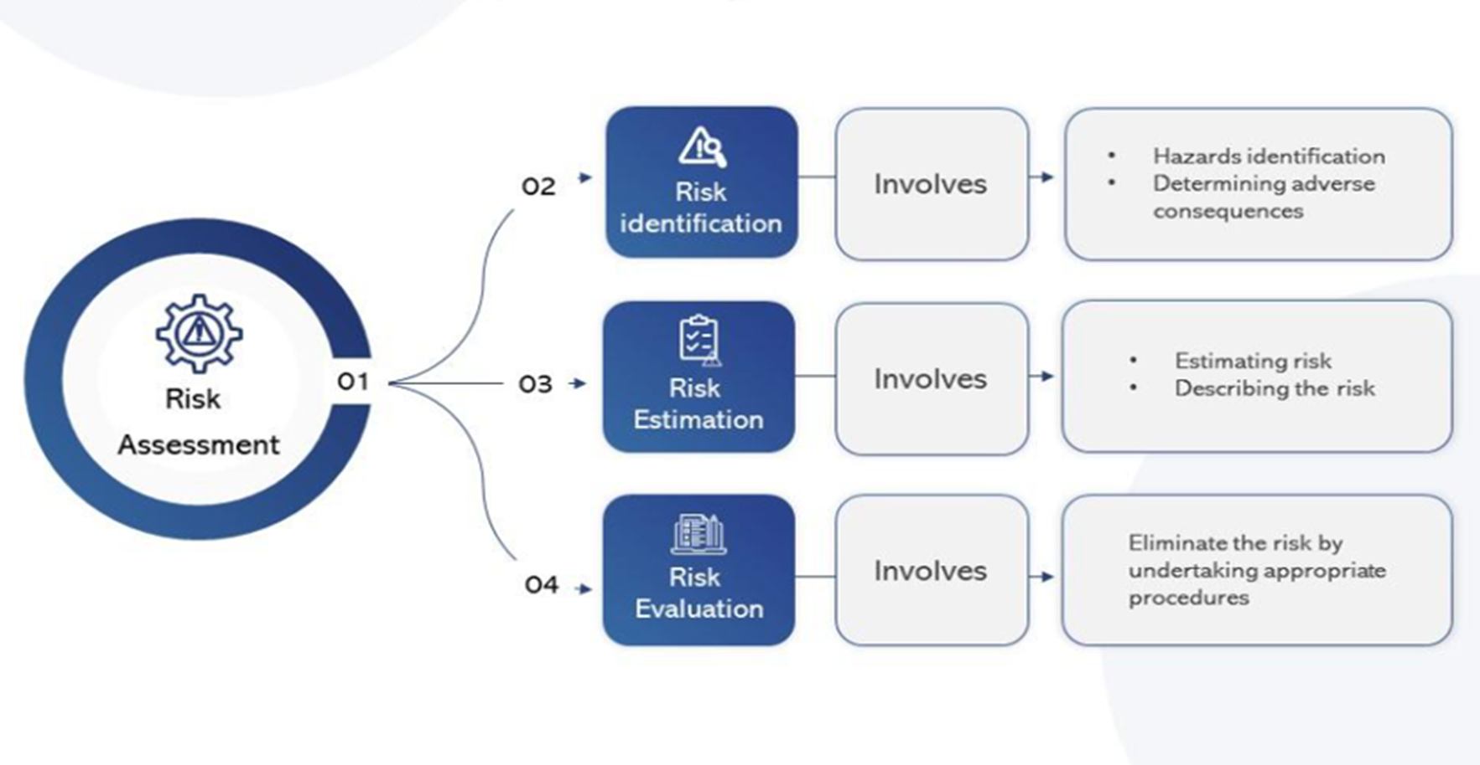

Slide 5
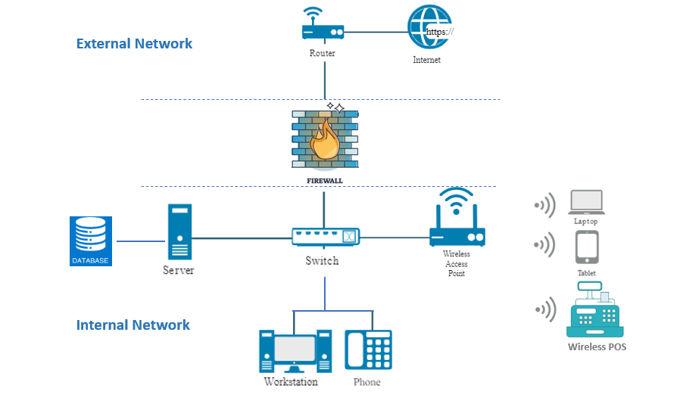
System Characterization

Slide 6
Assets Discovery
Asset | Threat | Vulnerability | Impact | Likelihood | Risk Score
Point-of-sale (POS) System
Invoice System
Students Log Management Database
Employee Sensitive Data Database
Email System
Wi-Fi network
Access Management Systems

Slide 7
Threat Discovery
Asset | Threat | Vulnerability | Impact | Likelihood | Risk Score
Point-of-sale (POS) System | Malware Infection, Ransomware attack
Invoice System | Unauthorised access, Data Integrity
Students Log Management Database | Data breach, Unauthorised access, database misconfigurations
Employee sensitive Data Database | Unauthorised access, database misconfiguration
Email System | Phishing, Malware attack, Spam, DoS
Wi-Fi network | Unauthorised access, MitM
Access Management System | Weak Password, Insider Threat

Slide 8
Vulnerability Discovery
Asset | Threat | Vulnerability | Impact | Likelihood | Risk Score
Point-of-sale (POS) System | Malware Infection, Ransomware attack | Weak password, outdated software
Invoice System | Unauthorised access, Data Integrity | Unprotected document, Fake invoice generations
Students Log Management Database | Data breach, Unauthorised access, Database Misconfigurations | Inadequate access controls
Employee sensitive Data Database | Unauthorised access, database misconfiguration | Inadequate access controls
Email System | Phishing, Malware attack, Spam, DoS | Insecure email configurations
Wi-Fi network | Unauthorised access, MitM | Weak encryption
Access Management Systems | Weak Password, Insider Threat | Improper access controls

Slide 9
Factors considered to scale the Likelihood of exploitation
Level | Description | Factors
5 | Trivial to exploit | Low effort, No technical skills required, No effective controls
4 | Moderately easy to exploit | Some effort, basic technical skills, controls may have weaknesses
3 | Moderately difficult to exploit | Moderate effort, Moderate Technical knowledge, effective controls
2 | Difficult to exploit | High-level technical skills required, strong and effective controls in place
1 | Extremely difficult to exploit | Exceptional technical skills needed, very strong and effective controls

Slide 10
Factors considered to scale the Impact
Impact Level | Description | Factors
5 | Catastrophic | Severe consequences, widespread damage, irreversible loss.
4 | Critical | Extensive damage, significant disruption, long recovery. Considerable damage, notable disruption, moderate recovery.
3 | Major | Considerable damage, notable disruption, moderate recovery.
2 | Minor | Limited damage, minimal disruption, quick recovery.
1 | Negligible | Almost no impact, easily manageable, negligible recovery.

Slide 11
Risk Assessment Matrix
Risk Score = Impact x Likelihood of exploitation
LIKELIHOOD
 | 1 | 2 | 3 | 4 | 5
1 | 1 | 2 | 3 | 4 | 5
2 | 2 | 4 | 6 | 8 | 10
3 | 3 | 6 | 9 | 12 | 15
4 | 4 | 8 | 12 | 16 | 20
5 | 5 | 10 | 15 | 20 | 25
I
M
P
A
C
T

Slide 12
SEVERITY LEVEL OF THE RISKS
Risk Level | Risk Score | Risk Description
High | Greater than > 15 | Risks with a very high severity have the potential to cause significant damage to the organization, such as financial losses, reputational damage, or regulatory compliance violations.
Medium | 6 to 15 | Risks with a medium severity have the potential to cause minor damage to the organization, such as financial losses, reputational damage, or operational inefficiencies. These risks should be addressed as resources allow.
Low | 1 to 5 | Risks with a low severity have the potential to cause very little damage to the organization. These risks may be monitored and addressed as needed. Risks with a very low severity have the potential to cause negligible damage to the organization. These risks may be ignored.

Slide 13
DEFINING SEVERITY LEVEL OF RISKS WITH DESCRIPTION
Risk Level | Description | Example
High | The risk is very serious and could have a significant impact on the company | Data breach Phishing attack leads to employee credentials leak Ransomware attack Malware infection, but not detected DDoS attacks
Medium | The risk is moderate and could have a noticeable impact on the organization. | Compliance violations DoS attack Phishing attack leads to employee credentials leak but immediately identified and fixed Malware infection, but detected
Low | The risk is minor and could have a small impact on the organization. | DoS attack detected and blocked by firewalls Phishing attack detected and blocked by email security control system Malware detected and blocked by antivirus software

Slide 14
Impact, Likelihood, Risk Score
Asset | Threat | Vulnerability | Impact | Likelihood | Risk Score
Point-of-sale (POS) System | Malware Infection, Ransomware attack | Outdated software, weak encryption standards | 5 | 5 | 25
Invoice System | Unauthorised access, Data Integrity | Unprotected document, Fake invoice generations | 5 | 5 | 25
Students Log Management Database | Data breach, Unauthorised access, Insider Threat | Inadequate access controls, No MFA enabled | 5 | 4 | 20
Employee sensitive Data Database | Unauthorised access, database misconfiguration | Inadequate access controls | 5 | 3 | 15
Email System | Phishing, Malware attack, Spam, DoS | Insecure email configurations, weak password | 4 | 3 | 12
Wi-Fi network | Unauthorised access, MitM | Weak encryption | 2 | 2 | 4
Access Management Systems | Weak Password, Insider Threat | Improper access controls | 2 | 2 | 4

Slide 15
Risk Score Explanation and Recommendations
Risk: High
Asset: Point-of-Sale Machine
Threat: Malware Infection and Ransomware attack, DoS
Vulnerability: Outdated Software, PCI DSS Compliance issues, weak encryption mechanism
Impact: 5
Likelihood of Exploitation: 5
Risk Score: 25
Security Recommendations:
Update the software with patch and follow the PCI DSS Compliance
Use End-to-End encryptions
Use strong password and 2FA to avoid unauthorised access

Slide 16
Risk Score Explanation and Recommendations
Risk: Medium
Asset: Email System
Threat: Phishing, Malware attack, DoS, Spam, MiTM
Vulnerability: Insecure email configurations, Outdated Antivirus
Impact: 4
Likelihood of Exploitation: 3
Risk Score: 12
Security Recommendations:
Update the Antivirus software, proper email configurations for outside organisation email address
Use Strong Password, Enable 2FA, Deploy spam filter softwares

Slide 17
Risk Score Explanation and Recommendations
Risk: Low
Asset: Employee Access Management System
Threat: Weak Passwords, Insider Threat
Vulnerability: Improper access control
Impact: 2
Likelihood of Exploitation: 2
Risk Score: 4
Security Recommendations:
Implement a access control to provide correct access to employees
Train the employees on security controls, password management, and Unauthorised access.

Slide 18
Conclusion
Recommendations:
Implement Regular Security Audit: Regularly review and update security protocols for critical assets like the Point-of-Sale and Email system
Enhance Employee Training: Provide comprehensive training on data security and access management to reduce human error-related risks.
Upgrade Technology: Invest in updated security software and hardware to protect against evolving cyber threats.
Immediate Risk Measures Required:
The assets like POS system and Invoice System should be secured with some security measures to avoid the cyber attack because these assets are more likely to be vulnerable to cyber attacks and have high risk score from this assessment.

Slide 19
Thank You

